Slide 1

Overview: Airport Grants
2023 SD Spring Airport Conference
Notes:
Airport Improvement Program (AIP); Bi-Partisan Infrastructure Law, known as BIL, with Airport Infrastructure Grants (AIG) and Airport Terminal Program (ATP) grants; Supplemental funds; COVID Relief funding with Coronavirus Aid, Relief, and Economic Security (CARES) Act, Coronavirus Response and Relief Supplemental Appropriation (CRRSA) Act, and American Rescue Plan (ARPA) Act. When we were preparing for the presentation that we wanted to make at this years State conferences, one of our ADO managers said our airport sponsors are overwhelmed by all of the grant programs. So I’d like to start this presentation by saying: If that list of acronyms didn’t overwhelm you, what will? AND the funding options have been so important during the last several years. We would like to keep this simple and offer an overview of where each of our airport sponsors should focus in regard to Airport Grants.

Slide 2
Andy Peek
Lindsay Butler
Sandy DePottey
Dan Millenacker
Simon Schmitz
Tracy Schmidt
Jake Martin
Gina Mitchell
Josh Fitzpatrick
Dave Anderson
Nancy Nistler
Brian Schuck
Jason Kral
Mark Holzer
Vacant
Sheri Lares
Sandy DePottey
Janelle Stocking
Angel Vennewitz
Nick Pratt
Vacant
Dakota-Minnesota Airports District Office
X
Management Team | 3
Program Assistant | 2
Civil Engineer/PM | 11*
Environmental Protection Specialist | 2
Community Planner | 2*
Total | 20
X
X
X
X
X
X
Airports in DMA-ADO
208 NPIAS Airports
1-Large Hub - MSP
2 Small Hub – FSD & FAR
X
X
Minneapolis Office
Bismarck Office

Slide 3
Dakota-Minnesota Airports District Office
Lindsay Terry
Jake Martin
Robert Hahn
Ben Garrow
Mark Johnson
Tracy Schmidt
Gina Mitchell
Marcus Watson
Dave Anderson
Mark Schrader
Jason Kral
Mark Holzer
Jeremy McLeod
Sheri Lares
Brian Schuck
Michelle Basquin
Grace Bingham
Kyle Sebesta
Nancy Nistler
Melissa Jenny
Casey Buechler
Vacant
David Ferrell
Management Team | 3
Program Analyst | 2
Civil Engineer/PM | 11*
Environmental Protection Specialist | 3
Community Planner | 3
Total | 22*
New Staff since 2020
Change in Position
Upcoming Retirement
# of Airports in DMA-ADO
208 NPIAS Airports
1-Large Hub - MSP
3 Small Hub – FSD, FAR & RAP
Minneapolis Office
Bismarck Office

Slide 4
Overview: Airport Grants
Focus on the use of AIP entitlement and anticipated BIL AIG allocations
Keep your Capital Improvement Program up-to-date to identify options for funding the future of the airport
Think through questions that you have and review FAA frequently asked questions (FAQs) available online
Apply for the competitive programs – however, they have been over-subscribed
Notes:
If you need to focus on a couple of things as your first step: please take a look at your Capital Improvement Program and make sure that you are providing your POC with the ADO to provide us with your insight about your most critical airport improvement needs and your vision for how you plan to use AIP entitlement funding and anticipated BIL AIG allocations.
If you have questions about the best way for you to integrate the use of AIP funding with the introduction of the relatively new BIL program, review the FAA Frequently Asked Questions (FAQs) (https://www.faa.gov/general/bipartisan-infrastructure-law-faqs) to see if the guidance from the FAQs information is helpful.
Beyond the AIP and AIG programs, you may have identified a project that may compete well under the ATP (Airport Terminal Program), FCT (Federal Contract Tower) competitive programs and Supplemental programs. But be forewarned the competitive programs have received requests for more funding than is available.

Slide 5
FAA Capital Planning Process
NPIAS
Defines the Public-Use Airport System
ACIP
Identifies detailed AIP-Eligible needs & priorities for the next 3 years (Internal FAA only)
AIP
Provides funds for Current year (Internal FAA until announced)
Establishes short (1-5 year) & long-term (6-20 year)
needs for AIP-Eligible development (Public Information)
Notes:
The FAA has been working within our Capital Planning Process for a number of years. You may be aware of these processes, but I want to talk about them just a little to help familiarize you with the elements that you may not know.
The FAA has been working within our Capital Planning Process for a number of years. You may be aware of these processes, but I want to talk about them just a little to help familiarize you with the elements that you may not know.
The National Plan of Integrated Airport Systems (NPIAS) is made public through a report to Congress that is required to be submitted every two years. Over the years, the general aviation airports that are included in the NPIAS were differentiated through the use of data about the use of the facilities into categories driven by the based aircraft numbers and use of instrument procedures.
The FAA conducted a national review of the general aviation airports resulting in two reports, General Aviation Airports: A National Asset issued in May 2012 and ASSET 2 issued in March 2014 (which focused on unclassified airports). Asset Classifications were incorporated into the NPIAS with the 2013 publication. Asset classification provided a way to differentiate but without real funding consequences until the use of the categories as a part of the allocation of AIG funding. This has now become more of interest to our airport sponsors than before as airports plan for the amount of allocations that can be expected in the period when BIL funding is provided.

Slide 6
FAA Airport Improvement Program
Authorization
AIP operates under Public Law 115-254 (FAA Reauthorization Act of 2018)
Authorizes $3,350,000 annually in AIP for the period beginning on October 1, 2018 and ending on September 30, 2023
Appropriation
President signed Consolidated Appropriations Act, 2023 (HR2617) on December 28, 2022 through September 30, 2023
Appropriates $3.35B in AIP for FY23
Notes:
Let’s talk for a moment about this year’s Airport Improvement Program funding. Programing may begin for entitlement only grants. If you are interested in using this funding in FY23, your FAA POC or SBGP POC needs to be aware of this by February 28th.
While the authorization and appropriation has been received for FY23, these are only in place through September 30, 2023. Needless to say, we are coordinating with airport sponsors and States to understand what interest there is for AIP funded projects in FY23. For those of you that plan to carry forward your entitlement funds, please proceed with those steps as soon as possible. The amount of entitlement that is carried forward is the drive for the amount of discretionary funding that is available.
In addition, we will all follow information about the Reauthorization of the Airport Improvement Program as it becomes available.

Slide 7
What is the difference between an Authorization and Appropriation?
Authorization
Appropriation
Allows the FAA to exist as an agency
Authorizes the imposition of ticket taxes & the use of those revenues flowing into & out of the Airport and Airway Trust Fund
Establishes basic statutory authorities & obligations (for FAA, airports, airlines & other users, & other stakeholders)
Gives FAA the authority to spend money – if & when it’s appropriated
Multi-year bill
Provides funds for authorized programs
Provides for the use of funds
Can provide additional funds other than authorized
Can have special allocations/funding rules
Annual bill – needed each year for funding

Slide 8


FAA MONEY
FY2023 Programs
Airport Improvement Program (AIP) Grants
BIL (AIG and ATP)
Supplemental (FY18-19-20-21-22-23)
COVID Relief Grants
  CARES Act Grants
  CRRSA/ACRGP Grants
  ARPA Grants

Slide 9
SD COVID Relief Grants
Special Grant Program | # of Airports with Remaining funds | $ Remaining Funds
CARES Act | 17 Airports – 4 at 100% 1 Development Addendum | $3,538,379 $455,158
CRRSA | 26 Airports – 18 at 100% | $1,212,379
ARPA | 38 Airports – 28 at 100% 2 Airports with Concessions funds | $11,508,335 $493,760
Notes:
CARES – Sioux Falls
Platte
Eureka
Sisseton
Highmore

Slide 10
COVID RELIEF GRANTS
Coronavirus Aid, Relief, and Economic Security (CARES) Act
Coronavirus Response and Relief Supplemental Appropriation (CRRSA) Act
American Rescue Plan (ARPA) Act
Amount | $10,000,000,000 | $2,000,000,000 | $8,000,000,000
Spend & Close | 4-year period of performance | 4-year period of performance | 4-year period of performance
Reimburse Operations Costs Incurred After | January 20, 2020 | January 20, 2020 | January 20, 2020
Reimburse Debt Service Costs Incurred After | March 27, 2020 | December 27, 2020 | March 11, 2021
Operations Expenses | ·Routine operations costs, to include utilities, payroll, general upkeep (e.g., lawn maintenance). ·Rolling Stock - ie ARFF & SRE ·Maintenance projects (such as pavement crack sealing, seal coating, or minor concrete panel replacement) | Routine operations costs, to include utilities, payroll, general upkeep (e.g., lawn maintenance). | Routine operations costs, to include utilities, payroll, general upkeep (e.g., lawn maintenance).
Procurement | 2 CFR 200 | 2 CFR 200 | 2 CFR 200
Buy American | Yes Exceptions: PPE, Cleaning Supplies, and other items with limited useful life | Yes Exceptions: PPE, Cleaning Supplies, and other items with limited useful life | Yes Exceptions: PPE, Cleaning Supplies, and other items with limited useful life
More Information | https://www.faa.gov/airports/cares_act | https://www.faa.gov/airports/crrsaa | https://www.faa.gov/airports/airport_rescue_grants

Slide 11
FAA MONEY
FY2023 Programs
Airport Improvement Program (AIP) Grants
BIL (AIG and ATP)
Supplemental (FY18-19-20-21-22-23)
COVID Relief Grants
  CARES Act Grants
  CRRSA/ACRGP Grants
  ARPA Grants

Slide 12
SD Supplemental FY2018-2022

Slide 13
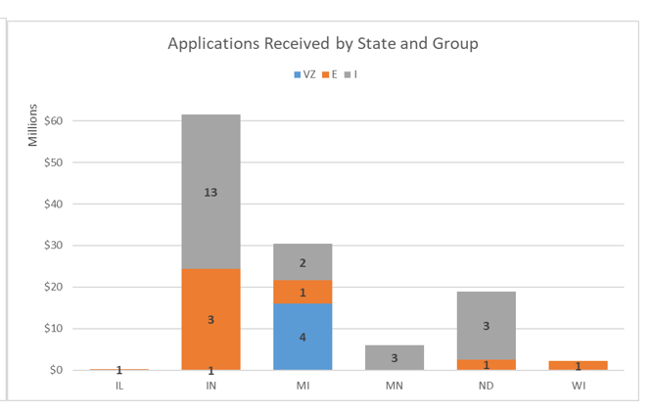
Supplemental 2022 Applications
Notes:
To recap, the FAA received 450 applications, totaling approximately $2.4B. There is only $268M available to award. In AGL we had a total of 33 projects, totaling $119.4M. We received applications from all but 2 states, Ohio and South Dakota. Applications include VALE/ZEV, Environmental, and Infrastructure project groups; we did not receive any Noise projects.

Slide 14
FAA MONEY
FY2023 Programs
Airport Improvement Program (AIP) Grants
BIL (AIG and ATP)
Supplemental (FY18-19-20-21-22-23)
COVID Relief Grants
  CARES Act Grants
  CRRSA/ACRGP Grants
  ARPA Grants

Slide 15
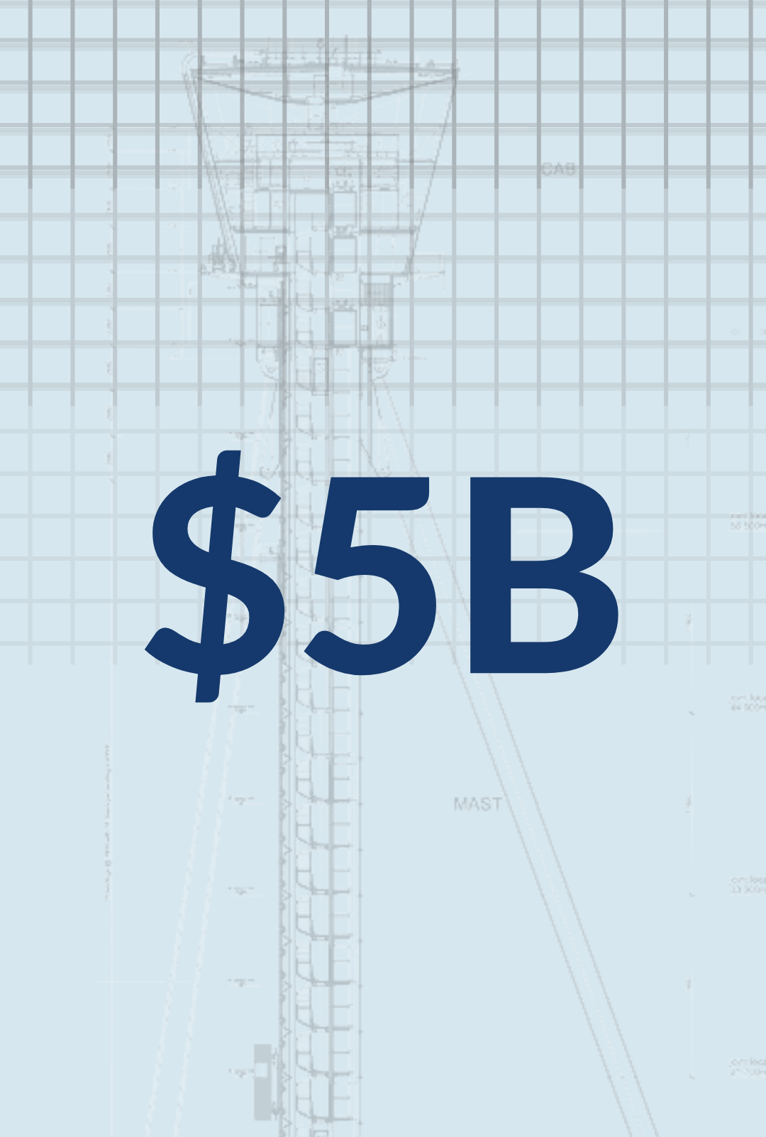
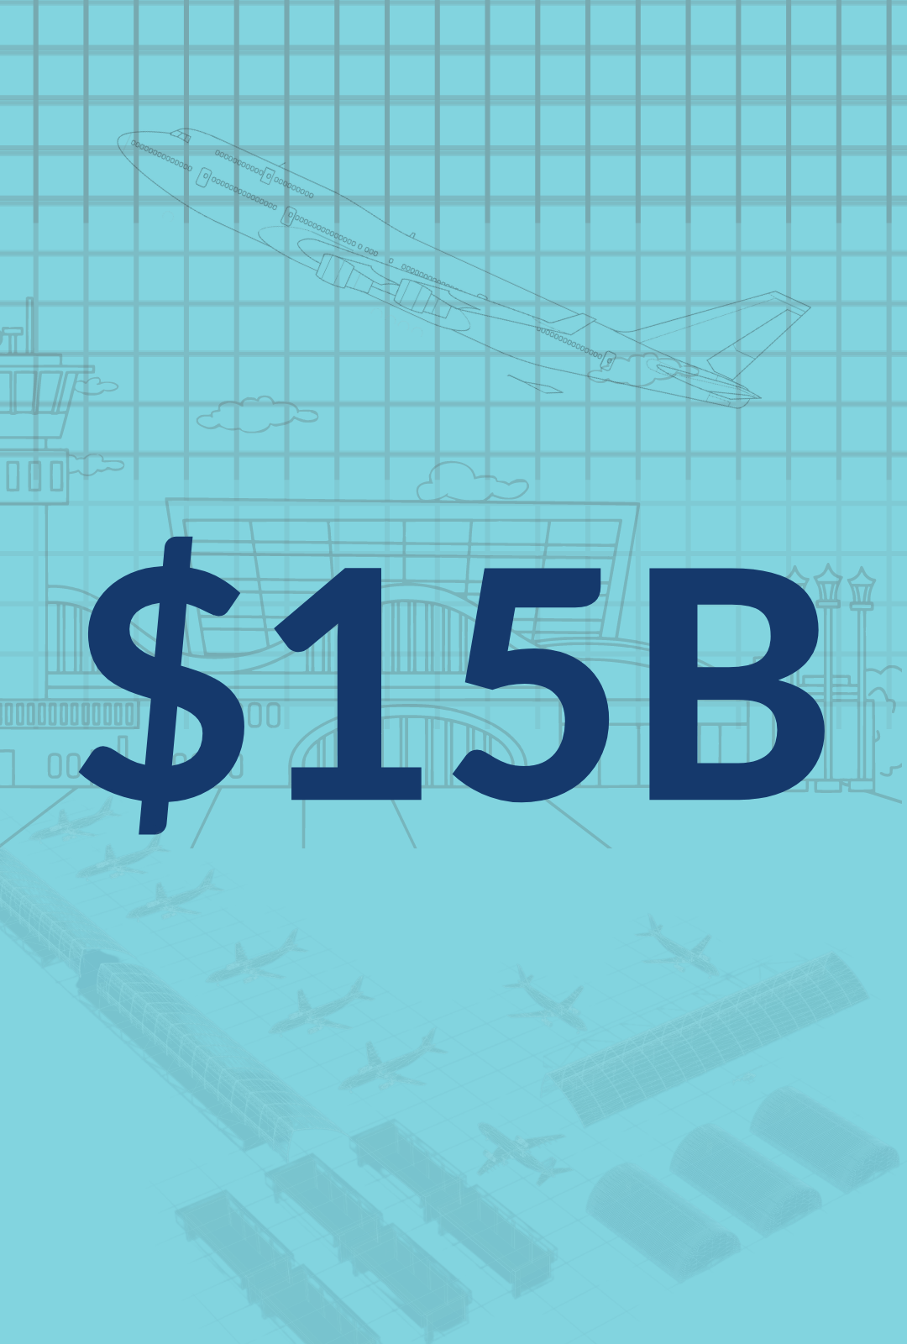

A 5-year, $25 billion investment in the Nation’s air transportation system.
AIR TRAFFIC FACILITIES
To replace facilities and equipment and improve safety, security, and environmental standards.
AIRPORT INFRASTRUCTURE
For airport projects that increase safety and expand capacity.
AIRPORT TERMINALS
To replace aging terminals and airport-owned towers, increase terminal energy efficiency and accessibility, and more.
2
Notes:
Before talking about the Bi-artisan Infrastructure Law (BIL), I always like to begin with recognition of the various “buckets” of funding that is available for use by the FAA. Initially, I’d like to talk about the Airport Infrastructure portion and the steps that have been taken to allocate and get AIG funding under grants in FY22 and FY23.

Slide 16
Airport Infrastructure Grant Program (AIG)
  $2.89 billion/year over 5 years based on formula distribution
    Up to $2.39 billion/year for primary airports based on passenger and cargo volume
    Up to $500 million/year for non-primary airports based on development cost needs of airports with the same NPIAS role
    Funds not used within 4 years will be lost and converted to discretionary programs
  FY22 and FY23 apportionments are available to airports
  FY24 apportionments will be made by December 2024
  Sponsor-Owned FAA Contract Towers may apply for and receive $20 million/year over 5 years based on competitive award; in addition, first $100 million of AIG funds not obligated in 4 years are competitively awarded to FCTs
AIRPORT INFRASTRUCTURE
4
Notes:
So in addition to use of entitlement-only grants, the FY22 and FY23 apportionments for the AIG funding are available to airports. Airport sponsors across the country have been slow to proceed with use of the AIG funds.

Slide 17
SD BIL Allocated Funds
FY2022 - $16,374,859
FY2023 - $16,456,071
Notes:
FY2022
Basic $3,410,000 31
Local $2,544,000 16
Regional $590,000 2
Primary/CS $9,830,859 5
Grand Total $16,374,859 54
FY2023
Basic $3,729,000 33
Local $2,030,000 14
Primary $9,821,071 5
Regional $876,000 3
Grand Total $16,456,071 55

Slide 18
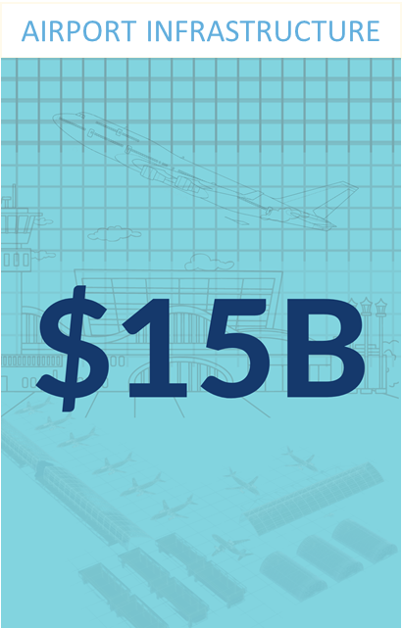
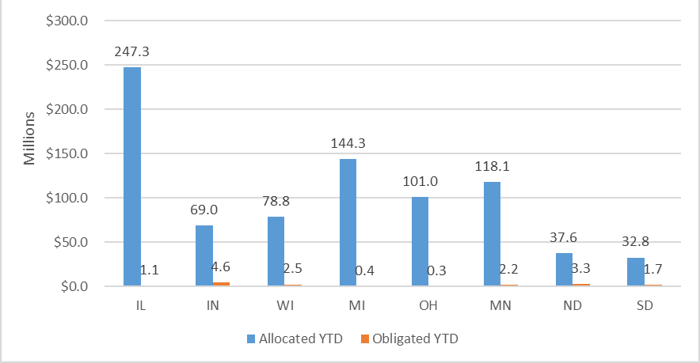
AGL AIG Year-to-Date (FY22 & FY23)
  FY22 & FY23 AIG Funding Available to Program
Notes:
In FY22 in South Dakota, we obligated $1.7M of the $16M available. In FY23, we have pre-application requests for over $13M of the remaining FY22 and FY23 available.
It is through the Capital Improvement Plan conversations that we anticipate learning about each airport sponsor’s plans for making use of the AIP entitlement and AGI allocations.

Slide 19
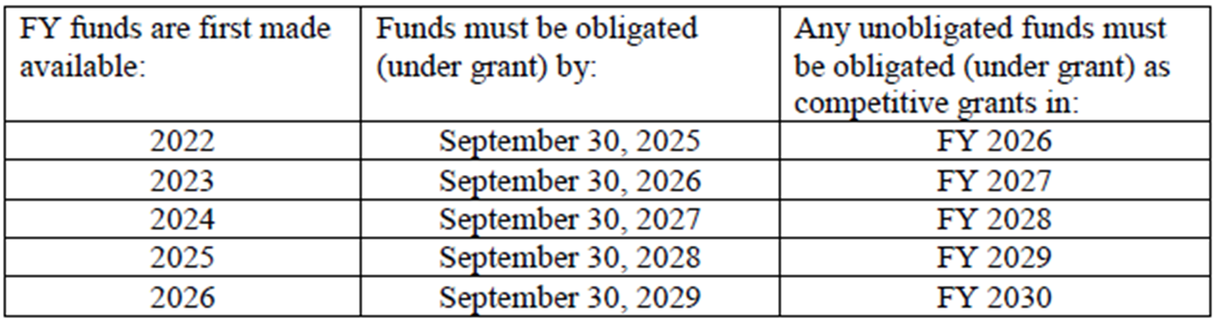
BIL AIG Funds Duration
4
Notes:
So why are we interested in making sure that there are plans for both your AIP entitlement and AIG funding?
For one thing this is the funding that is a “sure thing” for airport sponsors so long as the projects that are identified are AIP eligible. While they may be two very different projects, it is important to understand the distinctions between the two types of grant funding sources.
Here’s where there is a clock ticking on the BIL AIG allocations:
AIG funding does not carryover and we cannot multi-year the funds, they just are available and remain available until used or until expired.
AIG funding has short duration, as any remaining funds that has not been obligated by the end of the period that is established for each allocation will be put into a pot for competitive grants that will be made available during the last Fiscal Year of the BIL period. This is similar to expiring entitlement funds in AIP, which becomes converted into discretionary funding that is available in a competitive way.

Slide 20
AIRPORT TERMINALS
$1 Billion/Year - Over 5 years – Airport Terminal Competitive Grant Program (ATP)
Eligible projects include:
  Airport terminals and associated roadways
  Multimodal terminal projects
  On airport rail access projects
  Airport sponsor owned towers
  So long as the competitive application process for the Airport Terminal Program (ATP) is oversubscribed, consider competing for funding is a long shot
7
Notes:
Let’s talk about the Airport Terminals Program. It is a competitive process that is set into motion in a Notice of Funding Opportunity (NOFO) published through a Federal Register Notice. During the two rounds of competitive applications we received project applications that far exceed the amount of funding available. It is because of the number of applications that were received that we say: think of an ATP application as a long shot.

Slide 21
ATP Selection Status and Results
FY22:
  91 projects selected at 85 airports totaling $968.6 million in funding
  658 applications received requesting $14.2 billion received
FY23:
  NOFO announced September 28, 2022 and closed October 24, 2022
  658 applications received requesting $9.6 billion
  Applications under review with announced selections anticipated in February 2023
FY24:
  NOFO planned for release by September 2023
5
Notes:
FY22: 113 applications requesting $852.1 million in funding received in AGL
DMA: 16 Applications – 10 Airports - $87,812,631
ND: 5 Applications – 4 Airports - $9,790,131
FY23: 120 applications requesting $602.7 million in funding received in AGL
DMA: 17 Applications – 14 Airports - $159,641,000
ND: 6 Applications – 5 Airports - $18,431,000

Slide 22
FY 2023 ATP Applications
658 total applications for about $9.6 billion in projects received by October 24 at 5pm ET deadline
  Includes 57 applications for tower projects
Application by airport type:
* Note: These figures represent total applications submitted, based solely on the informal data provided by the airports, prior to FAA start of evaluation process.
5
Notes:
Regarding the “over-subscribed” statement about competitive applications: the table in this slide overviews just how over-subscribed the FY23 competition has been.

Slide 23
ATP Selection Overview
Selection Criteria:
  Improve airfield safety through terminal relocation
  Replacing aging facilities
  Increase capacity and passenger access
  Encourage competition
  Improve Energy Efficiency (including LEED accreditation)
  Expand access for persons with disabilities
  Improving airport access for historically disadvantaged populations
Other considerations:
  Project is justified and can be quickly put under award (FY23 - July 2023)
  Project creates good paying jobs
  Project advances White House priorities and Executive Orders
  Funding will complete a project or the project has already received a partial award
9

Slide 24
Tips for a successful ATP application
Submit application early to avoid last minute technical difficulties
Confirm project is eligible and justified
Have a detailed and complete financial plan
Write to each criteria and provide details how the project achieves each criteria
Make sure narratives are clear and concise
Digitally sign the application
Be ready to take a grant based on bids or negotiated price by the deadline in the NOFO
Work with your ADO throughout the year on planned projects
12
Notes:
The BIL Team has provided a list of tips regarding the ATP application. Probably the one that I point to first is that fact that any application for a competitive process should be submitted early. Don’t wait for the due date for the submittal. It is painful to say multiple applications were not accepted due to being 1 minute late. It takes time for an e-mail to go through, so I would not advise waiting until the last day, last hour, or pushing send during the five minutes before the due time. Ouch, right?

Slide 25
FAA MONEY
FY2023 Programs
Airport Improvement Program (AIP) Grants
BIL (AIG and ATP)
Supplemental (FY18-19-20-21-22-23)
COVID Relief Grants
  CARES Act Grants
  CRRSA/ACRGP Grants
  ARPA Grants

Slide 26
SD Grant History 2012-2022
Notes:
2012-2022
355 Grants = $ $340,939,220.33

Slide 27
SD AIP Open Grants
Open Grants | Number # | Available $
2019 | 3 | $2,535,659.06
2020 | 14 | $4,954,556.97
2021 | 13 | $2,446,000.44
2022 | 23 | $35,435,122.05
53 Open AIP Grants = $ $24,081,440

Slide 28
SD FY2023 Pre-Applications Received
Pre-applications were due to the FAA & State POCs by October 21, 2022
58 NPIAS Airports (3 Unclassified)
  34 AIP Projects
  19 BIL Projects
If you are not pursuing a grant, a statement saying that and what you would like to do with your entitlements (carryover or transfer) –
  An email is acceptable for carryover – Please use updated form for transfer

Slide 29
FY23 AIP & BIL Grants Calendar
Currently: Programming Grants
  Cannot program without environmental determination
Feb/March: Monthly announcements began
May 5: Entitlement only applications w/ bids
June 15: Carryover/Transfer deadline
End of July: Final Programming deadline
August 1: Final Closeouts for FY2023
Mid August: All bids required (AIP & AIG)*
September 18: ALL GRANTS SIGNED!
Notes:
All bids required – reservation date (AIP & AIG)*
*unless it is EOY funding for A7

Slide 30


Partnership with ADO
Communication is KEY!
Quarterly ADO Newsletter
Regular communications
Schedule a CIP meeting
Plan for Monthly meetings
Invite us to your airport
Always reach out with questions

Slide 31

Questions?
Please do not hesitate to give me a call or drop an email with further questions.
Lindsay Terry
ADO Manager
Dakota-Minnesota ADO
FAA Great Lakes Region – Airports
(612) 253-4630
Lindsay.Terry@faa.gov

